Slide 1
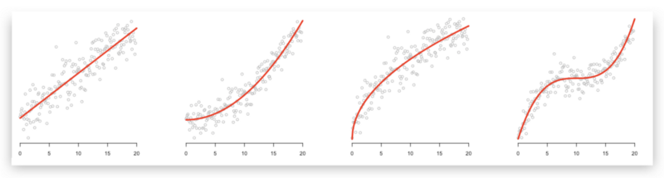
Regression deep-dive
Dmytro Kuzmenko

Slide 2
Lecture outline
About the speaker
Regression intro
Quick ML intro
Regression
On a high-level
On a low-level
Step-by-step pipeline
EDA and preprocessing
Model selection and validation
Metric selection
Optimizing hyperparameters and inferencing
Summary
Q&A

Slide 3

About me
BSc Software Engineering, MSc Applied Maths @NaUKMA
ML Researcher and Engineer @Infopulse, over 4 years of experience.
Research directions combine CV and RL in Healthcare and Assistive Technology. Recent projects include devising deep learning architectures for various domains such as spatiotemporal, audio, and textual data.
Currently focusing on the Adversarial Robustness in Deep Learning models.
Author of an AI-centred Medium blog.
Keen on mentoring everyone interested in ML. Striving to move AI in Ukraine.
LinkedIn, Website.

Slide 4
Quick ML intro
Short topology of types of Machine Learning:
Supervised learning
Predicting discrete variable – classification.
Predicting continuous variable – regression (this will be our focus).
Predicting ordinal variable – learning-to-rank.
Unsupervised learning
Clustering
Dimensionality reduction
Visualization
Semi-supervised learning
supervised learning tasks with conditions of almost unlimited access to unlabelled data, and very limited access to labelled one.
Reinforcement learning
The model’s algorithm interacts with both itself and the environment it interacts with (e.g. self-driving cars, board game engines, quadrupedal robots moving systems, etc.).

Slide 5
Regression on a high-level
Predictive model – a parametric family function (hypotheses).
Learning – a process of mapping from the set of data to a set of hypotheses.
Minimizing empirical risk – minimizing error function (difference between real and predicted samples’ values). In case of regression most common error functions are Mean Square Error (MSE) or Mean Absolute Error (MAE), we’ll talk about those in a bit.
Improving generalization and combating overfitting – there is always a risk that given a high degrees of freedom, too little data, or having been penalized too little, the model can overfit - perform well on training data, and completely fail at test (unseen data), which leads to a poor generalization.

Slide 6
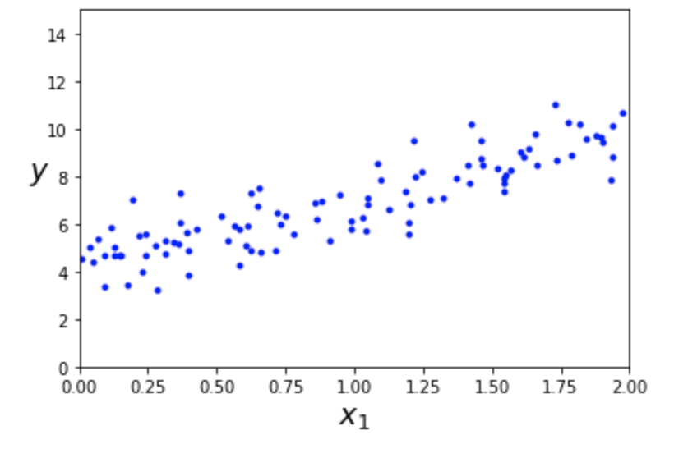
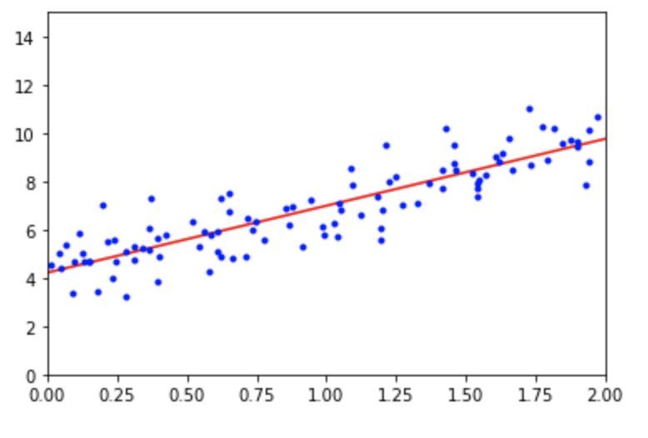
Regression on a low-level
Given the dataset of tabular data (i.e. 25000 rows X 30 columns), a target you are trying to predict (one of the columns), come up with a data to hypothesis mapping and minimize an error function.
⇒
Quick synthetic Linear regression example

Slide 7
Key assumptions for linear regression
Linearity: The relationship between X and the mean of Y is linear.
Homoscedasticity: The variance of residual is the same for any value of X.
Independence: Observations are independent of each other.
Normality: For any fixed value of X, Y is normally distributed.

Slide 8
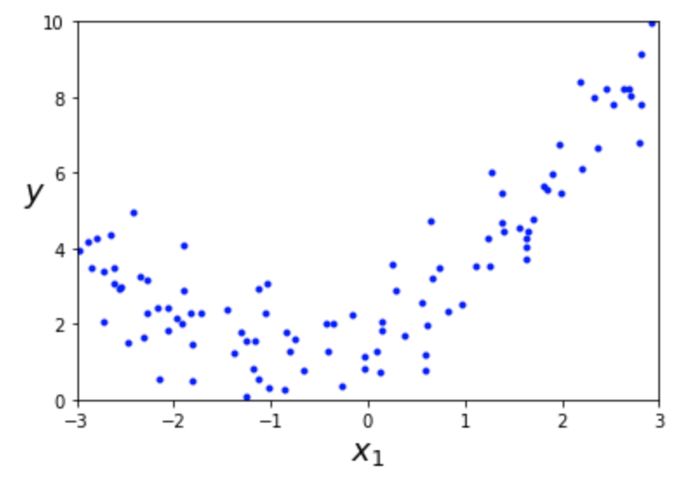
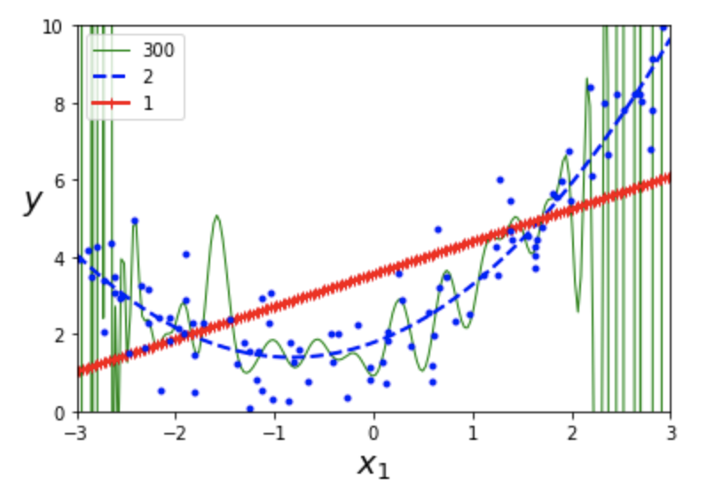
Polynomial Regression
Different degree polynomial fits. Red line is an apparent linear regression, blue dashed – a quadratic regression, while a green one is a completely overfitting 300-degree polynomial regression.

Slide 9
Step-by-step pipeline – EDA and pre-processing
Exploratory Data Analysis (EDA)
Open the dataframe in pandas, take a quick glance at the data looks like with df.head().
df.summary() or even more convenient PandasProfiling report can help you figure out the following:
Feature and target distribution, the amount of categorical (string-like), numerical (int, float), and ordinal (categorical with order) features.
The amount of missing data
Correlation between the variables.
Data preprocessing
We will keep it simple
One-hot encoding the categorical features
Normalising the numerical data to bring all the variables to the same range – subtract mean and divide by standard deviation.

Slide 10
Step-by-step pipeline – model selection and validation
3. Model selection
Linear and polynomial regressions
Support Vector Machine regressor
Tree methods
Gradient boosting
4. Choosing a proper validation:
Split the data set in approx. 70% train, 10% validation, 20% test data. Make sure to shuffle, unless your data has time dependencies.
With 80% of train + val data, do a KFold cross validation over 5 folds and average out the score over 5 fits.

Slide 11
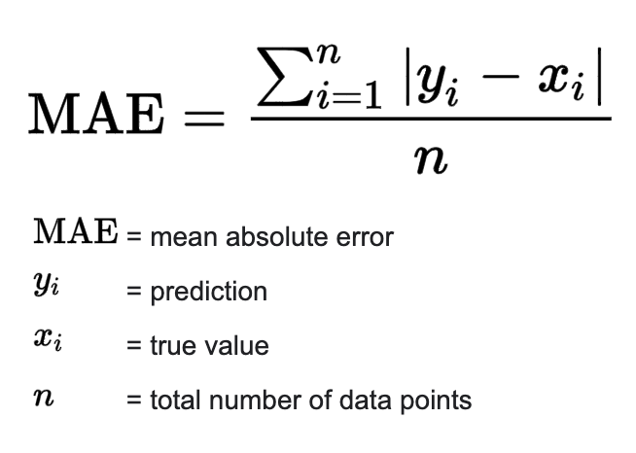
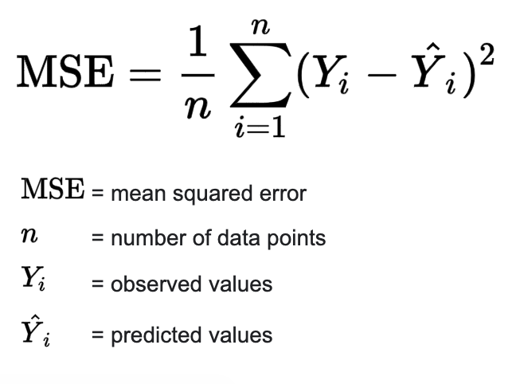
Step-by-step pipeline – choosing a metric
Square Error
Absolute Error

Slide 12
Step-by-step pipeline – optimizing hyperparams and inferencing
5. Fit the model choosing the right hyperparameters. Try:
GridSearchCV
RandomizedSearch
Optuna or HyperOpt libraries
tune them manually like a pro :)
6. Validate the model on your test set.
Make sure it doesn’t overfit (signals may be a big gap between train and test scores, train scores approaching extremely small MSE).
Reiterate the learning using the full dataset to get it ready for submission/production.

Slide 13







Different regression models from a showcase notebook
Linear and polynomial regressions
Tree-based models and LightGBM
Support Vector Regressor

Slide 14
Summary
Wide variety of models can be used for regression tasks
Main metrics – MSE, MAE.
Data preprocessing, namely validation, N/A handling, and normalisation are very important
Good validation is key
Basic regression modelling showcase on a house price prediction: notebook and data.

Slide 15

Now to questions
– Be curious and always do ask questions. It catalyzes the understanding and engagement with the topic by a lot.

Slide 16
Reference literature
Hands on Machine Learning with Scikit-Learn and Tensorflow, 1st part.
Good short reference article on Medium.
Legendary classic course by Andrew Ng for better overall grasp.
Any entry-level course focusing on regression tasks with sklearn and statsmodels. For instance this Course course on Stats.
Documentation from pandas, numpy, matplotlib.
Maths is important. Hence, decent probability theory and statistical base is important.

